Slide 1

Wazuh SIEM Solution: Features and Capabilities
Dominic Ozoekwe

Slide 2

AGENDA
- What is wazuh
- Wazuh Capabilities
Wazuh features
Wazuh architecture
Wazuh components
single-cluster installation
WAZUH SIEM DEPLOYMENT
WAZUH SIEM visualization

Slide 3
What is Wazuh?
The Wazuh Security Information and Event Management (SIEM) solution is a centralized platform for aggregating and analyzing telemetry in real time for threat detection and compliance. Wazuh collects event data from various sources like endpoints, network devices, cloud workloads, and applications for broader security coverage.
Wazuh offers a free and open-source solution that is both simple to install and easy to use. It's an ideal choice for small and medium-sized enterprises (SMEs) that may not have the budget for expensive SIEM solutions but still require robust security measures.

Slide 4
WAZUH CAPABILITIES
Log Management: Centralized log collection and analysis
Intrusion Detection: Real-time threat detection and response
File Integrity Monitoring: Continuous monitoring of file systems for unauthorized changes
Vulnerability Detection: Identifying and prioritizing vulnerabilities in the infrastructure
Compliance Monitoring: Ensuring adherence to industry regulations and standards
Incident Response: Automated response actions and incident handling
Security Analytics

Slide 5
WAZUH FEATURES
Alert and Notification: Configure Wazuh alerts to email, Slack, jira, SLA or ticketing platforms.
Reporting insights from SIEM events
Scalability: Ability to scale with the growth of the infrastructure
Flexibility: Customizable rules and policies to meet specific requirements
Integration: Seamless integration with other security tools and platforms
Open-source Community: Active community support and contributions

Slide 6
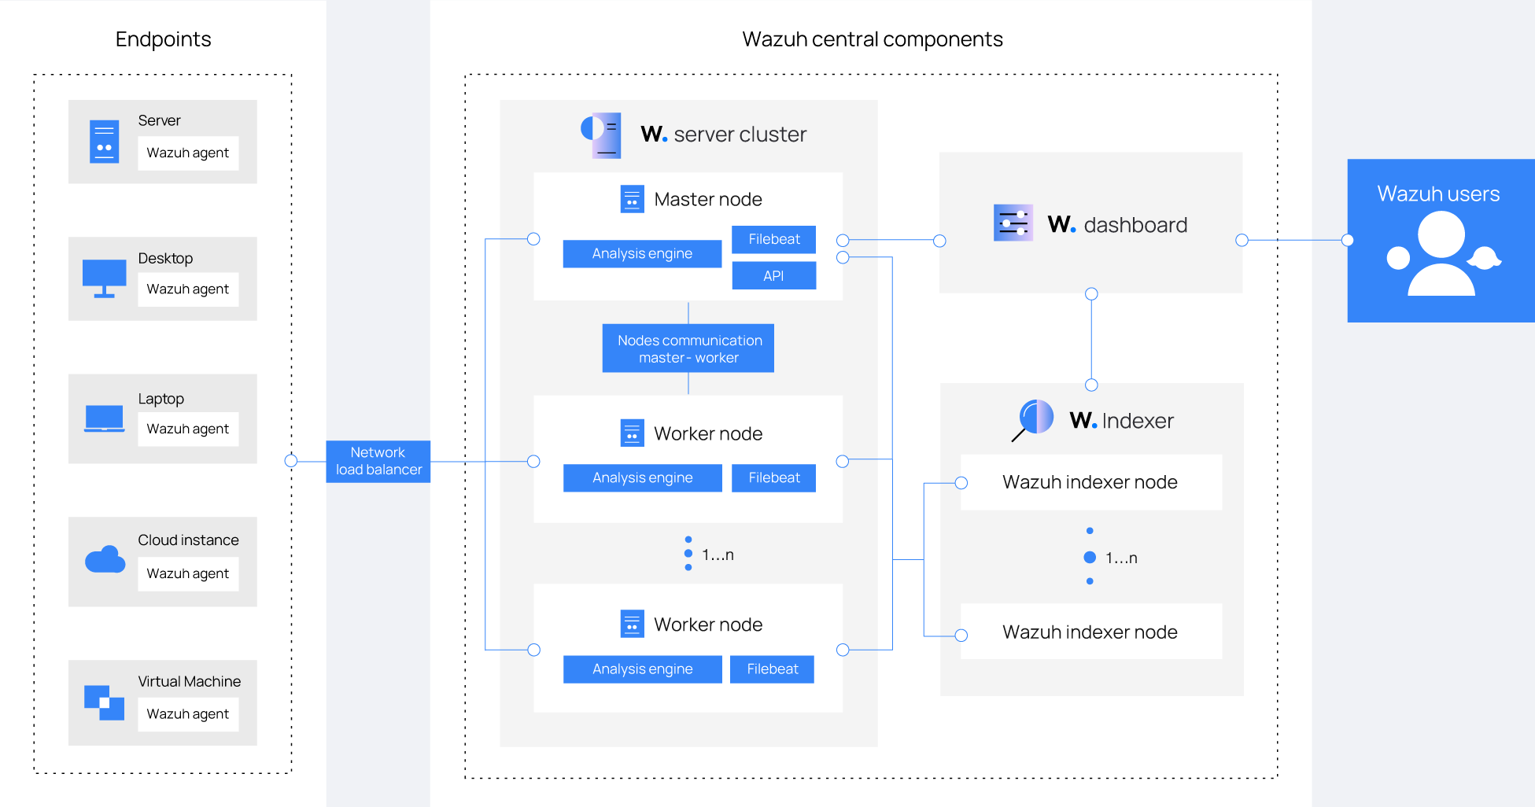
WAZUH ARCHITECTURE

Slide 7
WAZUH COMPONENTS
Wazuh Server
Wazuh Indexer
Wazuh Dashboard
Wazuh Agents

Slide 8
WAZUH SERVER
The Wazuh server serves as the central component responsible for managing agents, collecting data from them, processing security events, and enforcing security policies.
It acts as a coordinator for the entire Wazuh infrastructure. The server receives data from agents, performs analysis and correlation of security events, and generates alerts based on predefined rulesets.
Additionally, the server provides an API for interacting with the Wazuh system programmatically.
The server cluster may consist of multiple nodes.

Slide 9
WAZUH INDEXER
The Wazuh indexer component is responsible for storing and indexing the collected data in a scalable and efficient manner.
It typically integrates with a data storage and search engine such as Elasticsearch to provide fast and reliable storage of security-related information.
The indexer ensures that data is organized, searchable, and accessible for analysis and reporting purposes.
It plays a crucial role in enabling users to perform complex searches, correlations, and analytics on security events collected by Wazuh agents.

Slide 10
WAZUH DASHBOARD
The Wazuh dashboard provides a user-friendly interface for monitoring security events, visualizing data, and managing configurations.
It allows security administrators to view real-time alerts, analyze historical data, and configure various aspects of the Wazuh system.
The dashboard is typically accessed via a web browser and provides customizable dashboards, reports, and search capabilities to aid in security monitoring and incident response.

Slide 11
WAZUH AGENT
The Wazuh agent serves as a crucial component in the Wazuh architecture, facilitating security monitoring and threat detection across endpoints within an organization's network.
Lightweight and versatile, the agent is installed on each endpoint, including servers, workstations, and other devices, to collect security-relevant data and transmit it to the central Wazuh manager for analysis.

Slide 12
single-cluster installation
In a single-cluster installation on one host, the Wazuh architecture consolidates essential components (except the agent) onto a single server, streamlining setup and management.
While a single-cluster setup on a single host may lack the redundancy and scalability of multi-node deployments, it is an efficient approach for smaller-scale environments, testing, or development purposes

Slide 13
WAZUH SIEM DEPLOYMENT
Planning and Design: Begin by assessing your organization's security requirements, infrastructure layout, and deployment goals.
Infrastructure Setup: Set up the Wazuh infrastructure components.
Agent Deployment: Install the Wazuh agents on endpoints throughout your network.
Integration with Existing Systems: Integrate Wazuh with existing security tools and systems.
Configuration and Customization: Configure rulesets, thresholds, and alerting mechanisms to prioritize and respond to security incidents effectively.
Monitoring and Analysis: Monitor security events and data collected by Wazuh in real-time.
Continuous Improvement: Continuously monitor and evaluate the effectiveness of your Wazuh deployment.

Slide 14
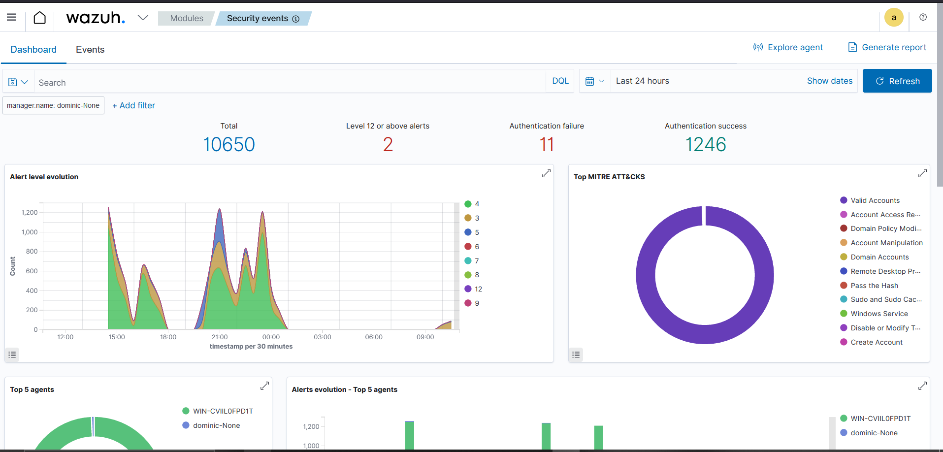
WAZUH SIEM visualization

Slide 15
WAZUH SIEM visualization

Slide 16

THANK YOU
Ozoekwe Dominic
+2347032909591
ozoekwedominic@gmail.com

